Slide 1
Capstone Project - II
Team 1 : Cardiovascular Risk Prediction
Team Members :
Shirsh Verma
Monika Shinde
Prashant Bhardwaj
Smruti Ranjan Pradhan

Slide 2
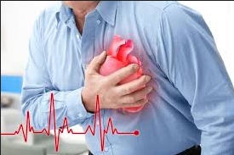

Problem statement :
Coronary heart disease is caused due to accumulation of plaque in major heart blood vessels
leading to blockage of oxygen-rich blood to heart.
It is the most common type of heart disease, killing about 300 K people in US alone every year.
The goal of our project is to come up with a ML model that correctly predicts 10-year risk of a patient having coronary heart disease (CHD).
The very important metric that we want to focus on is the Recall metric since we want to minimize false negatives i.e. person with 10-year CHD risk should be flagged positive by the model.

Slide 3
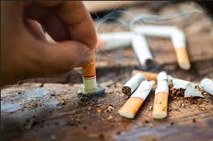
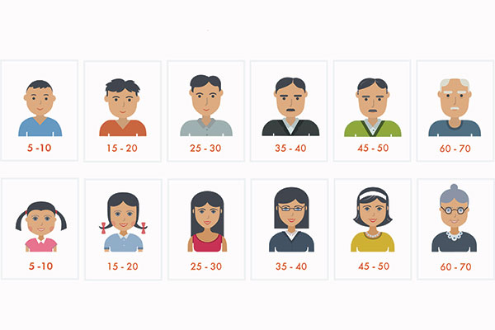
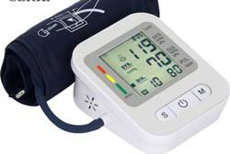
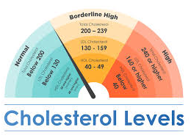

Features Present in Dataset :

Slide 4
Exploratory
Data Analysis

Slide 5
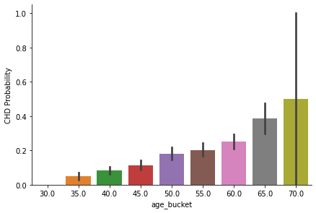
Does age play any role ?
Older people have a higher risk of
Having coronary heart disease in
next 10 years

Slide 6
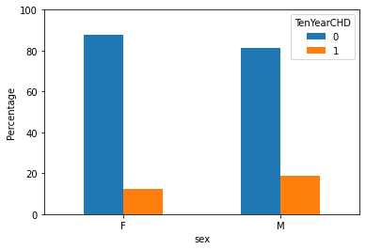
Sex
Men are generally at a higher risk
of having coronary heart disease

Slide 7
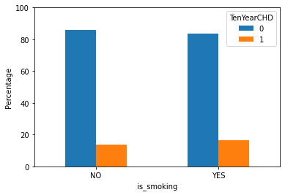
Smoking ?
Contrary to what we might anticipate,
Smoking has little to no role to play in
affecting the risks of CHD.
Statistically, 10-year risk of CHD is
not dependent on smoking with a 95%
confidence.

Slide 8
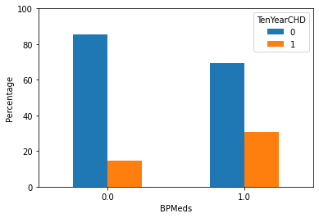
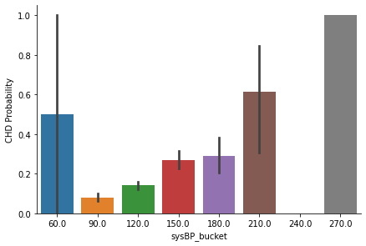
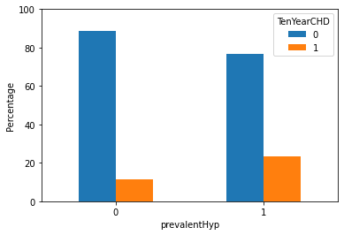
Other Notable Observations :
Patients who have a high blood pressure,
have a history of hypertension and have
been taking BP medication have
comparatively higher risk of CHD

Slide 9
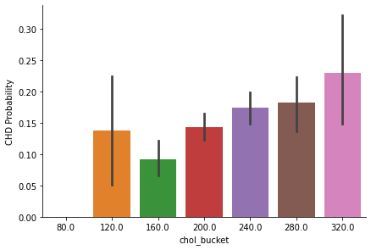
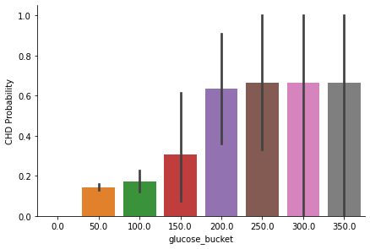
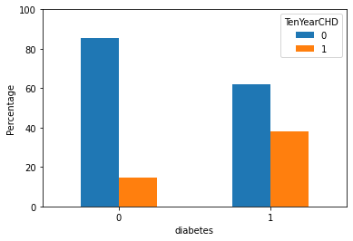
Other Notable Observations :
Similarly, patients with high cholesterol
and glucose levels (with diabetes) have
higher risk of having CHD.

Slide 10
Data Cleaning & Feature Selection

Slide 11
Dealing with Nulls
Categorical Variables : To fill up the absence of data in our categorical variables we have used simple imputer that imputes the null values with feature label that is most frequent in the feature column.
Continuous Variables : To treat the null values in continuous variables, we use KNN imputer which uses a unsupervised clustering algorithm to come up with values of the features.

Slide 12
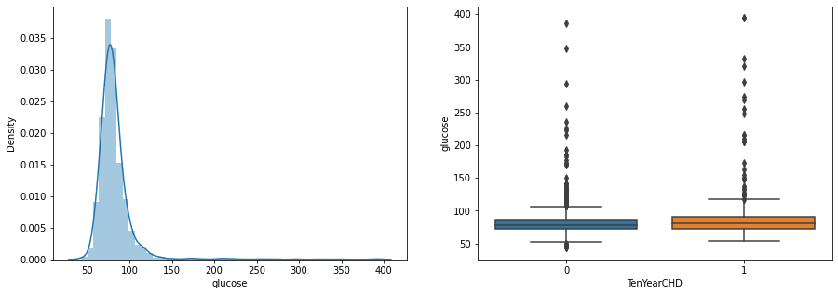
Dealing with outliers

Slide 13
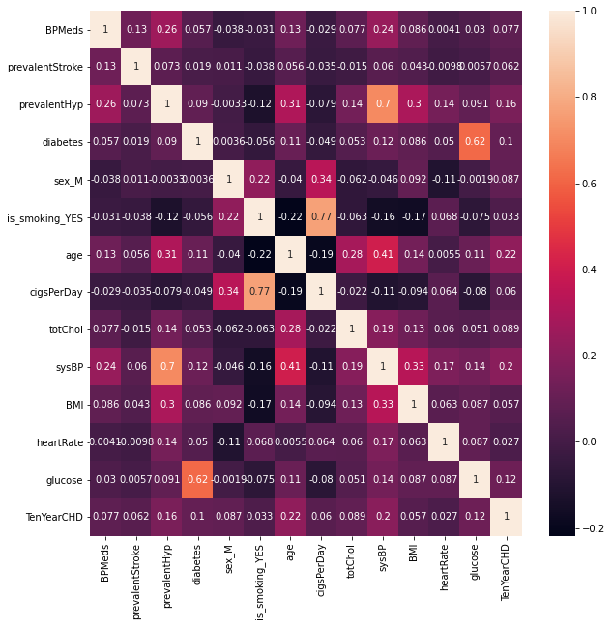
Feature Selection
There is significant correlation
between systolic BP and prevalent
hypertension.
Also features like is smoking and
cigarettes per day are correlated.
Similarly glucose level and diabetes
are correlated.

Slide 14
Final set of features :
Age
Sex
BP Meds
Prevalent Stroke
Systolic BP
Glucose
Total Cholesterol
Body Mass index
Heart Rate

Slide 15
Train-Test Split
Train dataset has 2712 samples while test dataset has 678 samples.
The split is such that the target variables classes are equally stratified over train and test dataset
Out of 2712 samples, 2303 samples are of class 0 i.e. patients with no risk of CHD, while 409 samples belong to class 1 i.e. patients with a risk of CHD.

Slide 16
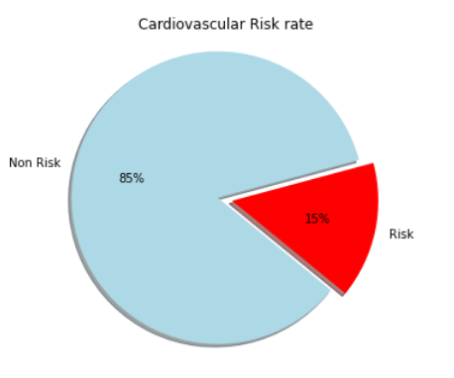
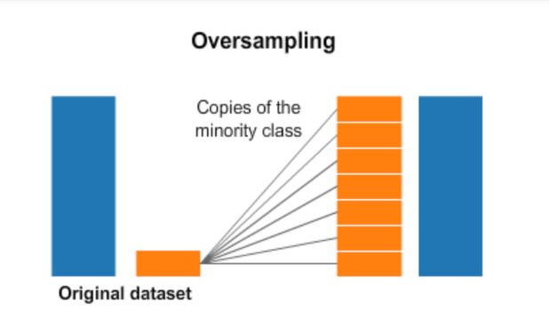
Addressing Class imbalance
Random over sampler on train dataset
After over sampling we have train set of size 4606 with 2303 samples of each of the class. Our dataset is now ready for training.

Slide 17
Modeling and Results

Slide 18
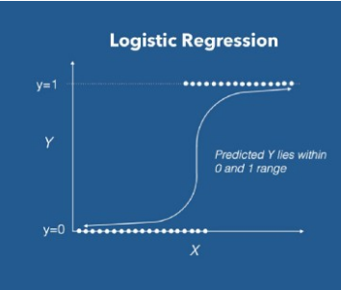
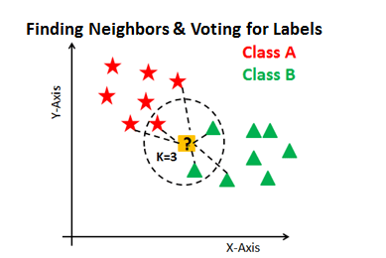
Using the training set, We trained five classifiers, i.e.,:

Slide 19
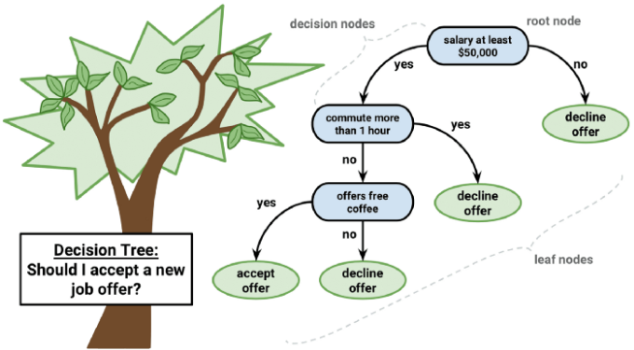
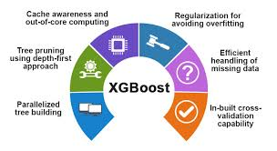
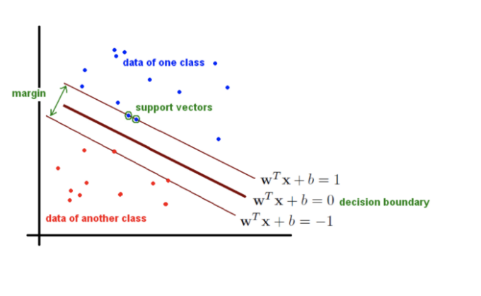

Slide 20


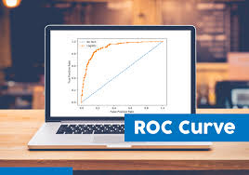
After training each model and tuning their Hyper-parameters using Grid Search, We evaluated and compared their performance using the following metrics:

Slide 21
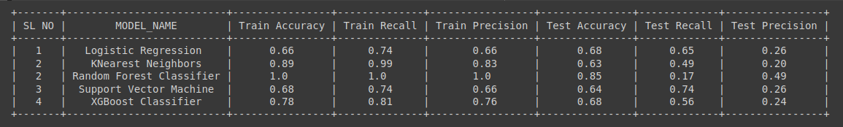
Models Trained
Best Performing Model : Support Vector Machines (SVC)
Since the recall on test set is 74% for SVC. However the precision is low ~ 26%, although precision on train set is 66%

Slide 22
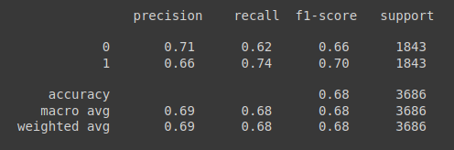
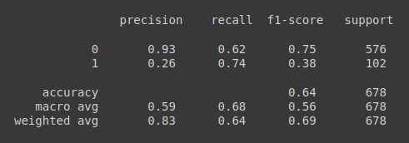
Confusion Matrix and Classification report of SVC
Train Set :
Test Set :
1144 | 699
471 | 1372
359 | 217
27 | 75

Slide 23
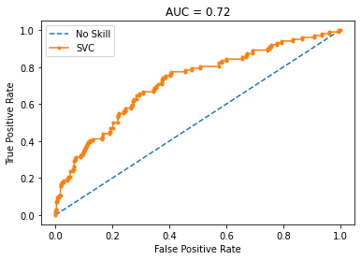
ROC Curve

Slide 24
Conclusion
This model can then be used as a simple screening tool and all that we need to do is to input ones: age, BMI, systolic and diastolic blood pressures, heart rate and blood glucose levels after which the model can be run and it outputs a prediction.
However, as a sanity check, most of the data on the positive cases were artificially created using ROS and as such they may not be a true representation of the actual population data thus more data, especially on the positive cases, is needed to build better models and much more potent screening tools.

Slide 25
Challenges and future work
Although the oversampled training data show higher recall and precision for minority class, precision of minority class in test data still remains a concern. However overall precision is good.
Although we have done feature selection based on their relevance to the target variable, it was challenging to come up with new engineered features that could explain hidden patterns in the data and classify our target variable better.
We might need to work more on feature engineering and improve our precision. We might as well expect data samples with positive risk of CHD to be available in future.

Slide 26
Thank You

